Slide 1


Machine Learning Algorithms :
(Linear Regression-
Gradient Descent)
Presented by Amira Khaled

Slide 2

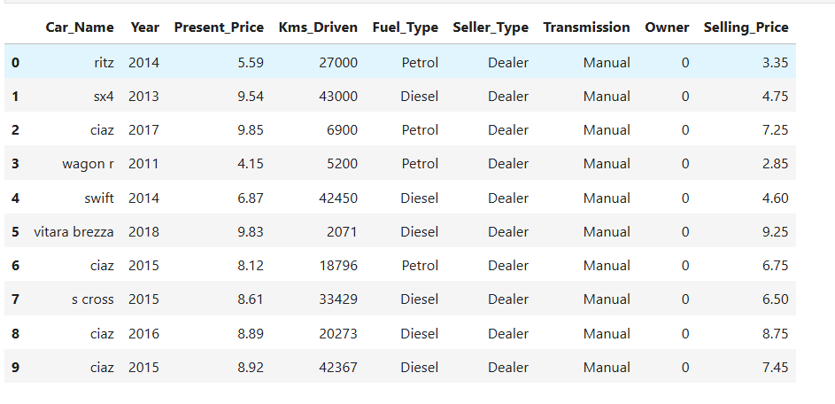


How machine learning work:

Slide 3
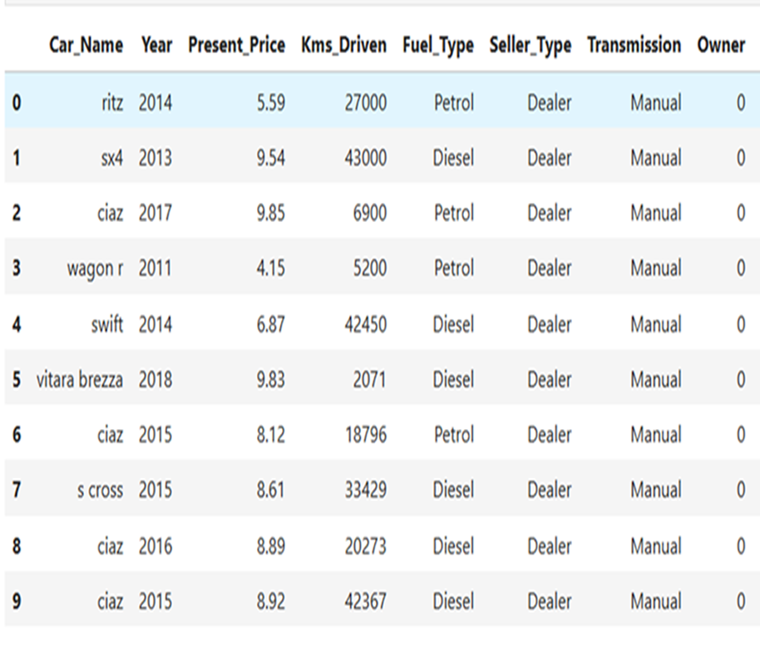

How machine learning work:

Slide 4

Training 80%
Testing 20%

Slide 5
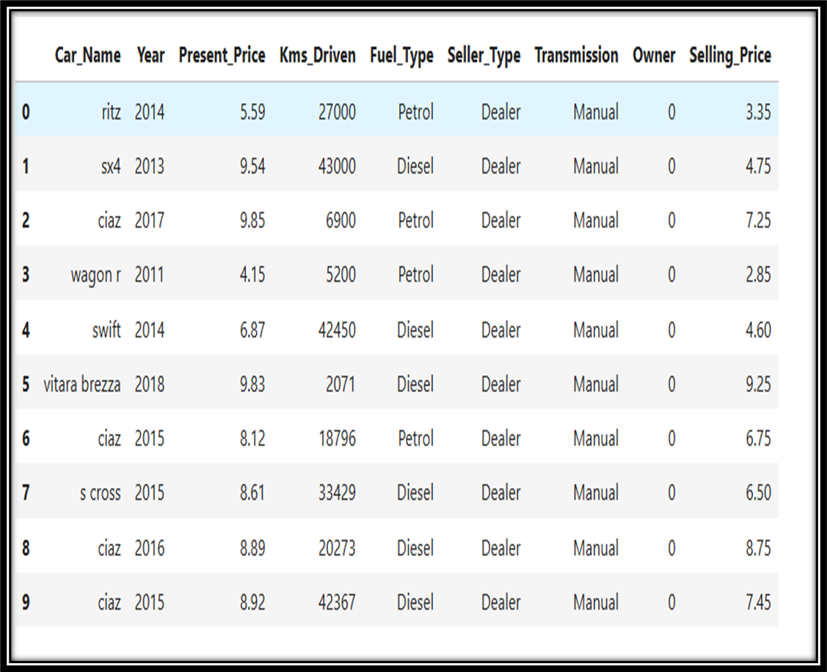
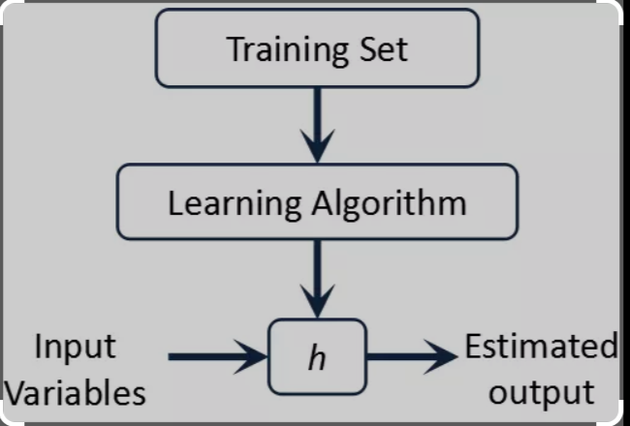
How machine learning work:

Slide 6
Types of ML Algorithms:
Algorithms
Supervised Alg.
Un-Supervised Alg.
Labeled:
Un-Labeled:

Slide 7
Types of ML Algorithms:
Algorithms
Supervised Alg.
Un-Supervised Alg.
Labeled:
Un-Labeled:

Slide 8
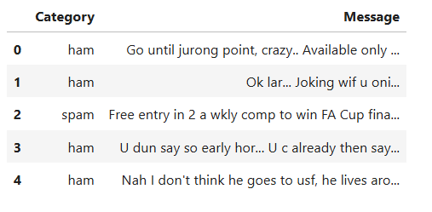
Types of ML Algorithms:
Supervised Alg.
Regression Alg.
Classification Alg.
continuous Values:
Discrete Values:

Slide 9
Types of ML Algorithms:
Regression Alg.
Linear Regression Alg.
Polynomial Regression Alg.

Slide 10
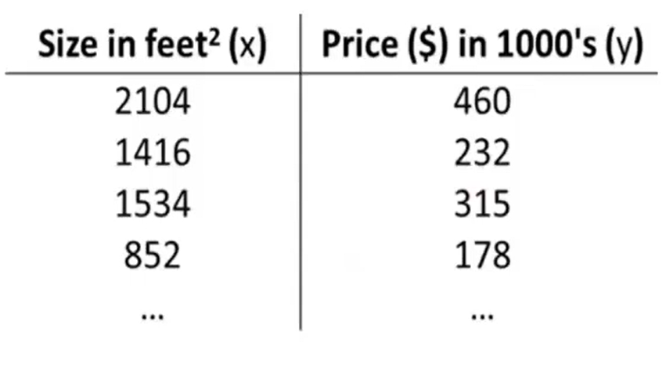
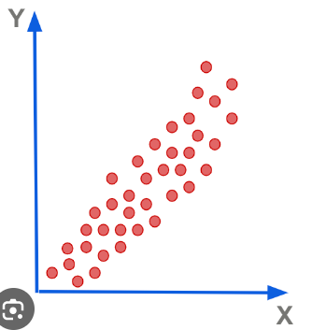
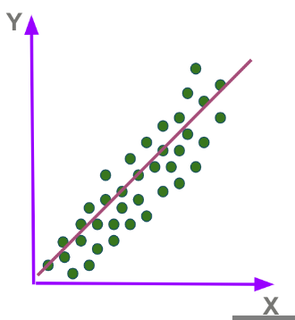

Linear Regression Algorithm

Slide 11
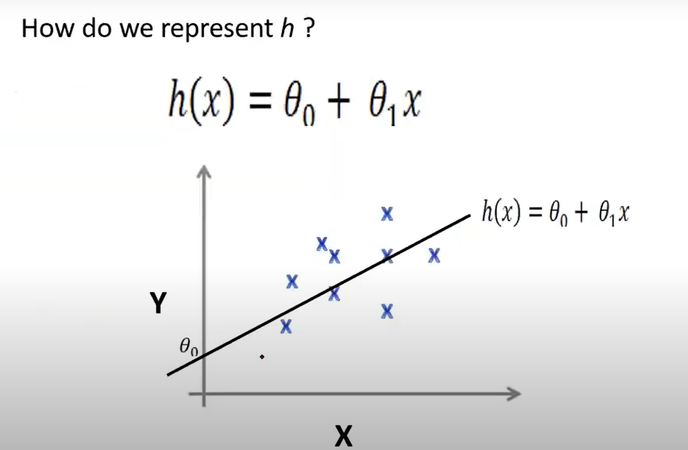


Linear Regression Algorithm
(With one variables)
Equation:

Slide 12
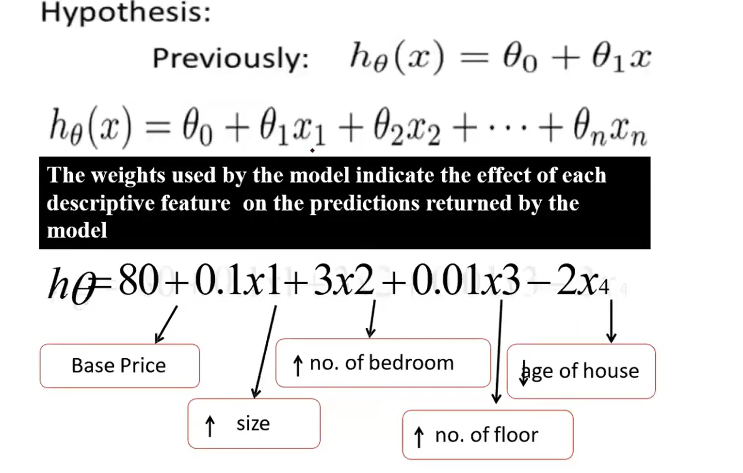

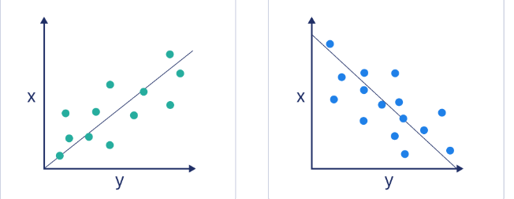
Linear Regression Algorithm
(With multiple variables)
+ve Correlation
-ve Correlation

Slide 13
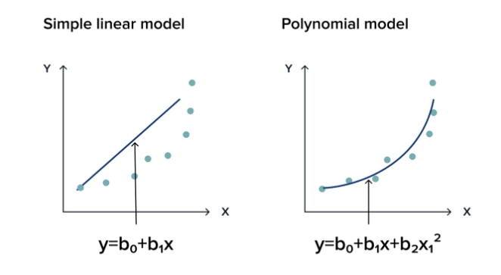


Slide 14
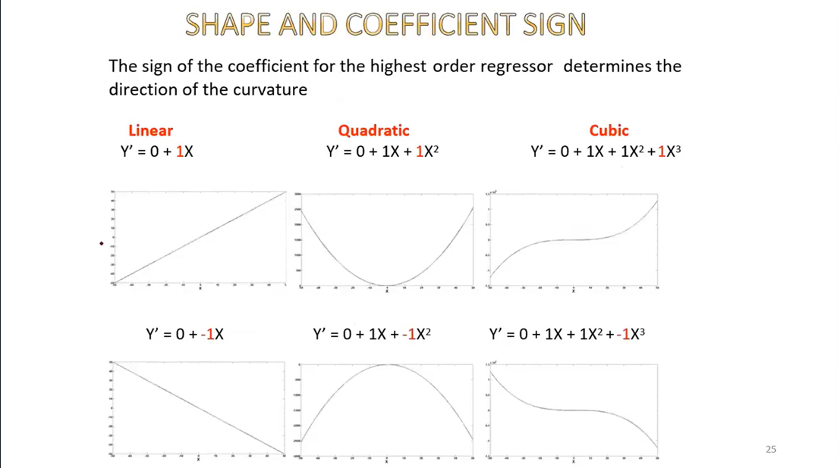

Slide 15
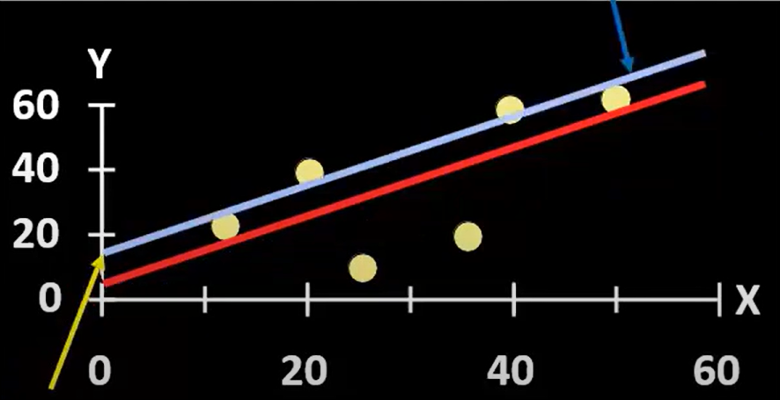
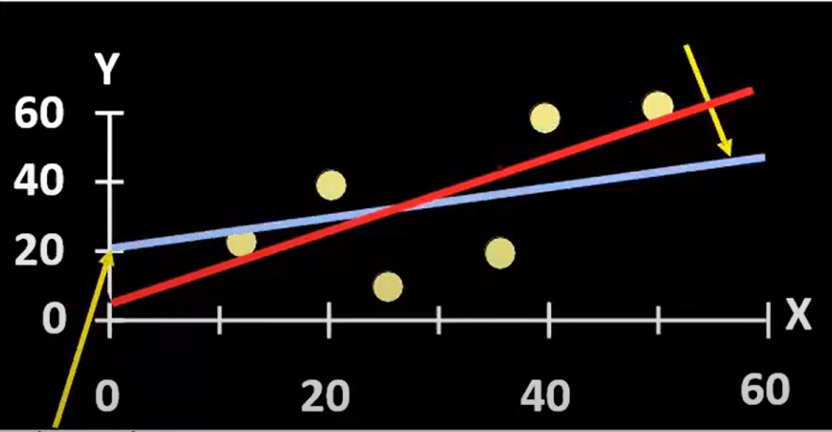
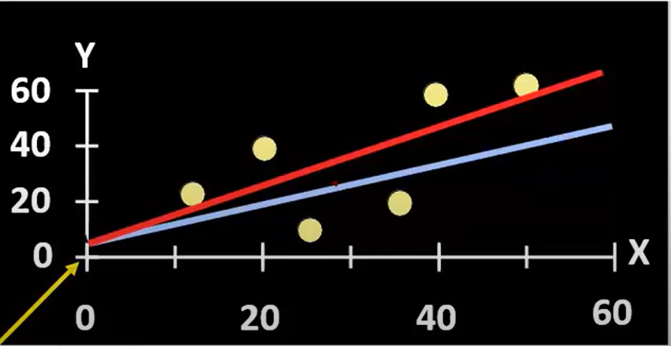
Intercept changed:
Slope changed:

Slide 19
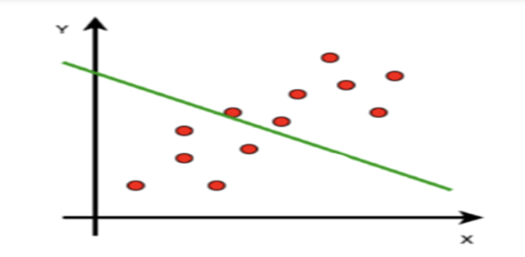
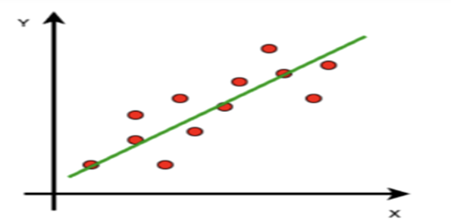

Slide 20
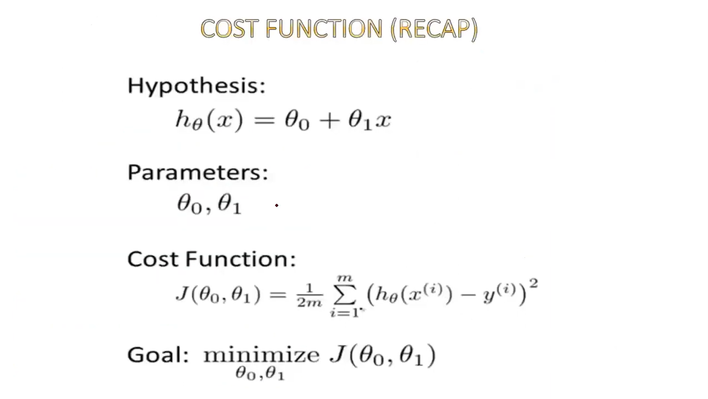
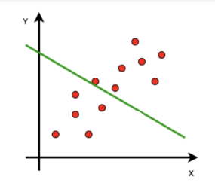






Slide 21
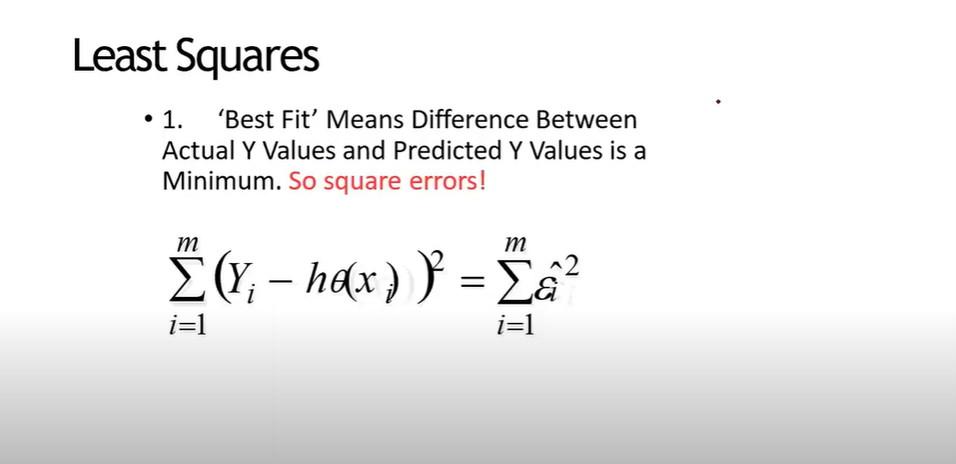
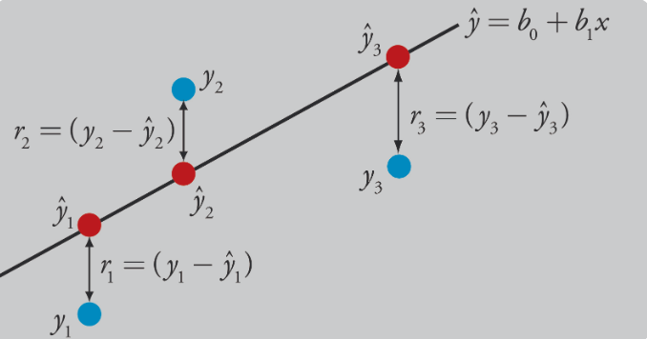
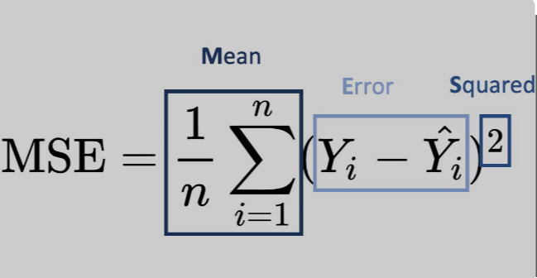

Least Square Error(LSE):
Loss function:
Mean Square Error(MSE):
Cost Function J(seta):

Slide 22
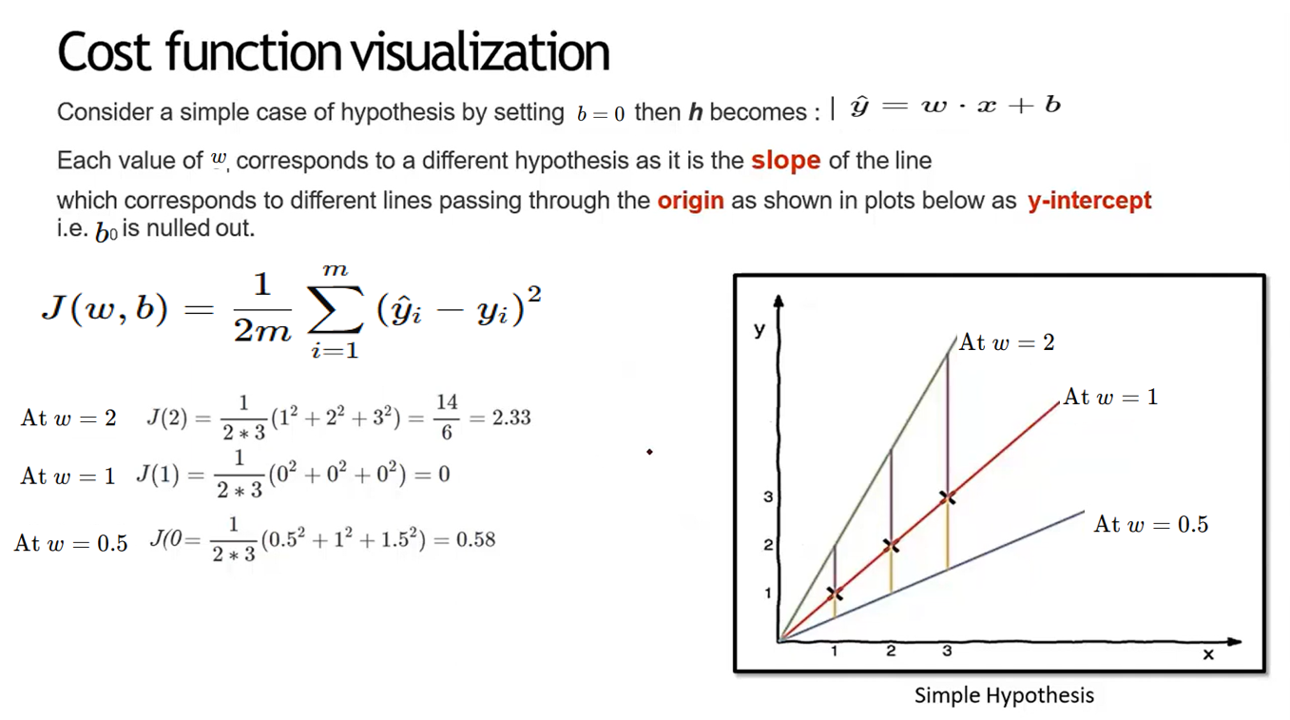

Slide 23
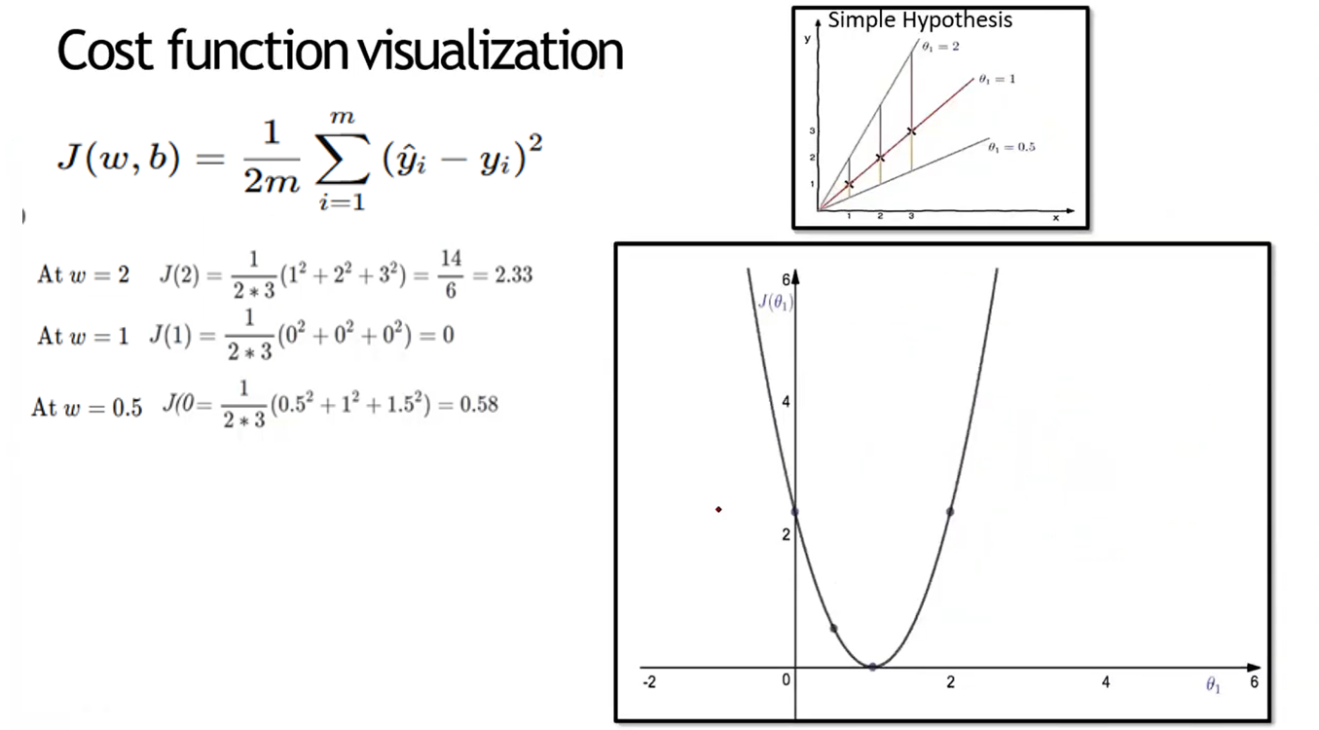

Slide 24
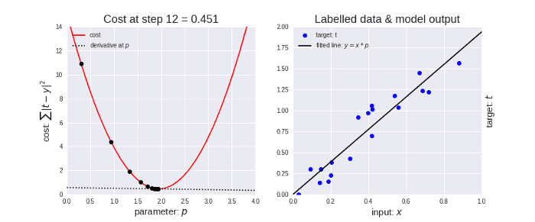

Slide 25
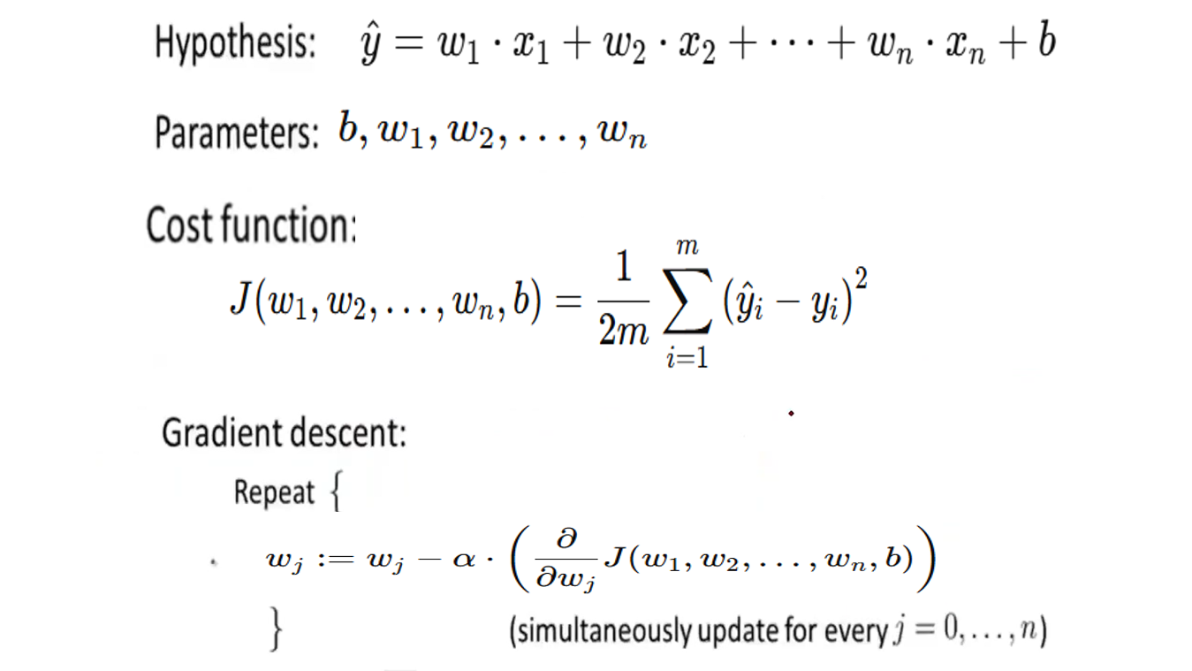

Slide 26
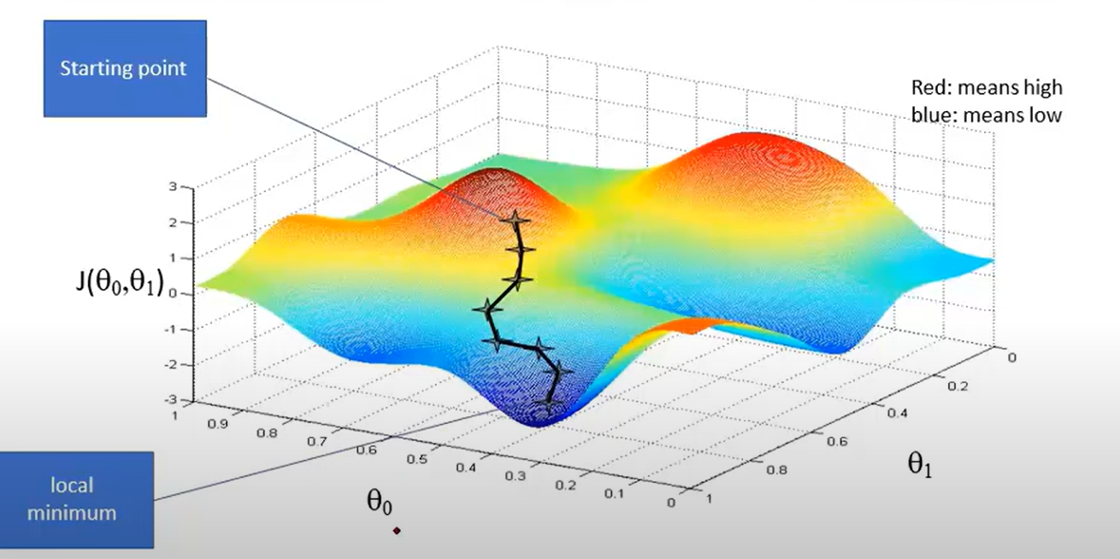

Slide 27
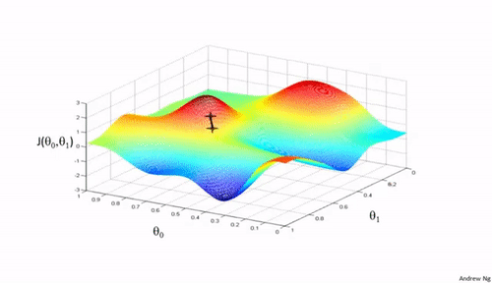

Slide 28
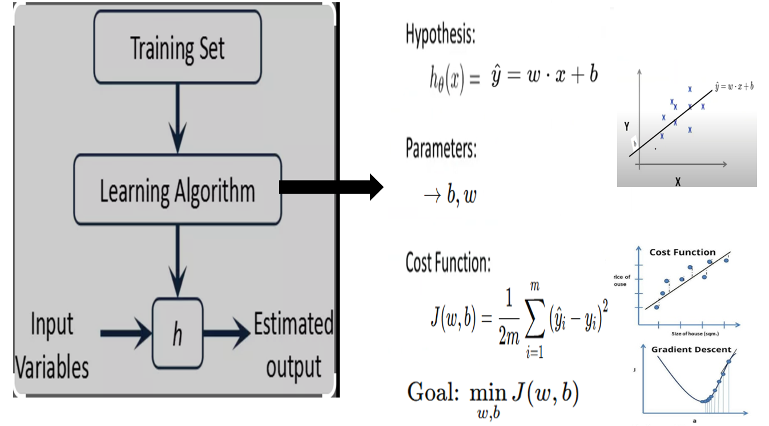

Slide 29
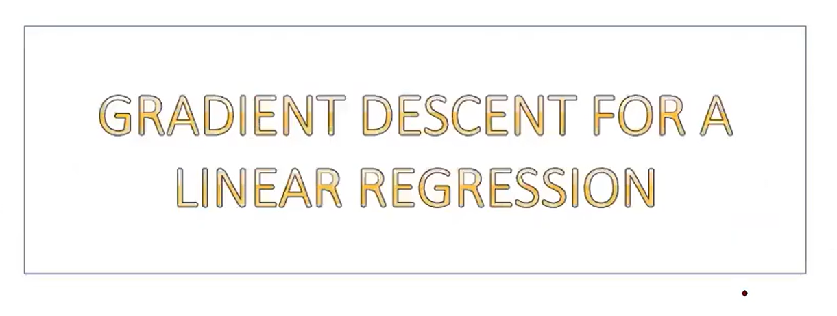

Slide 30
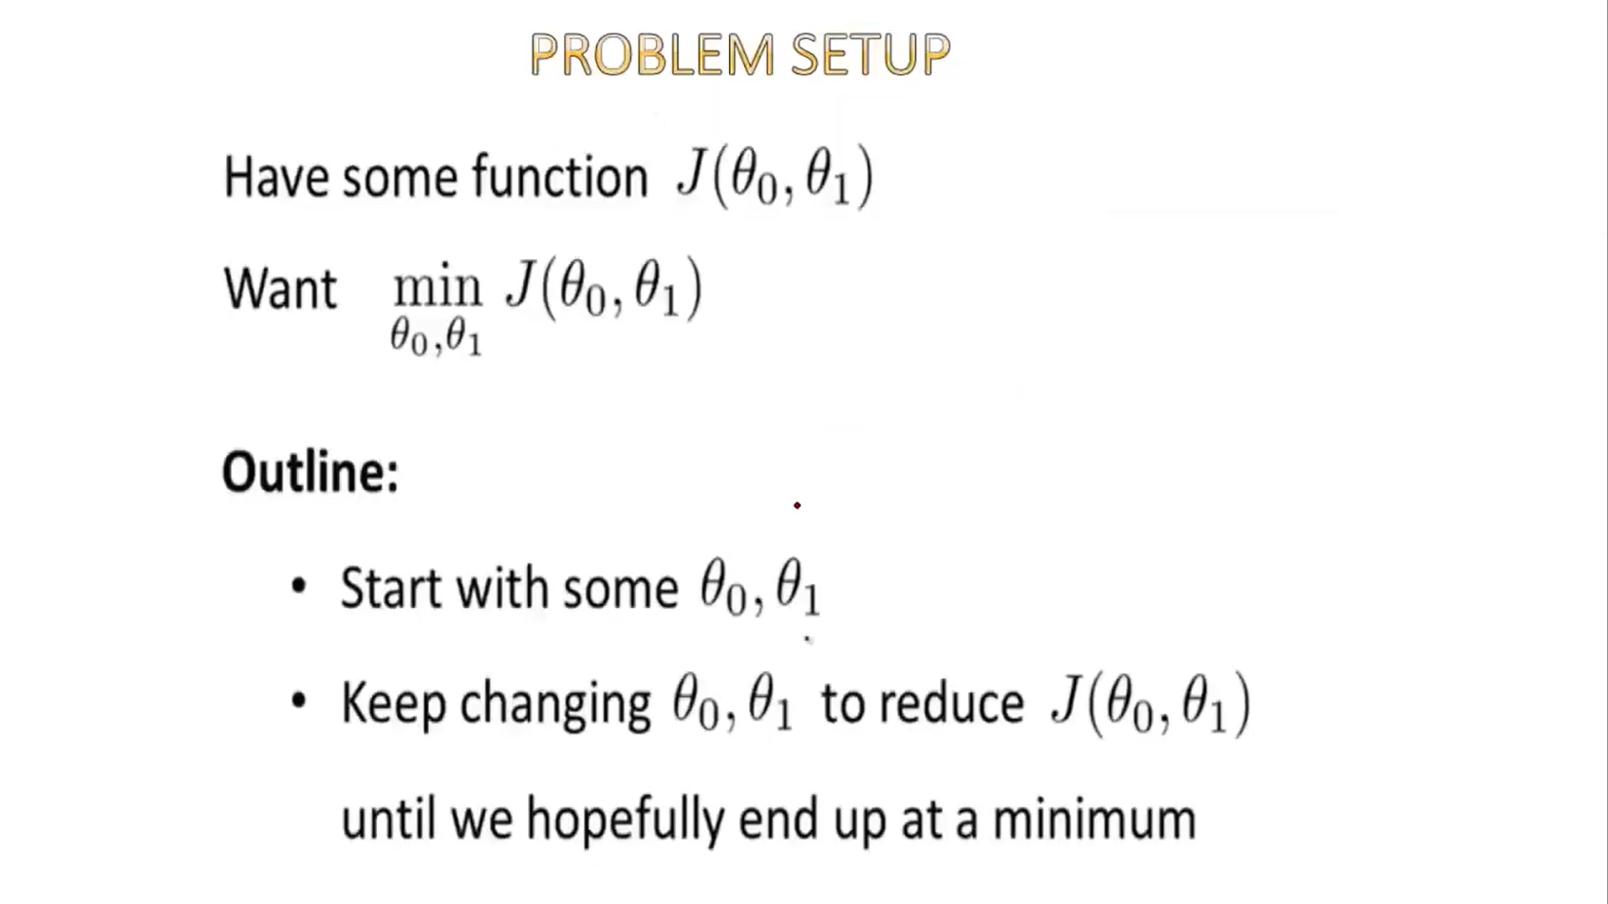

Slide 31
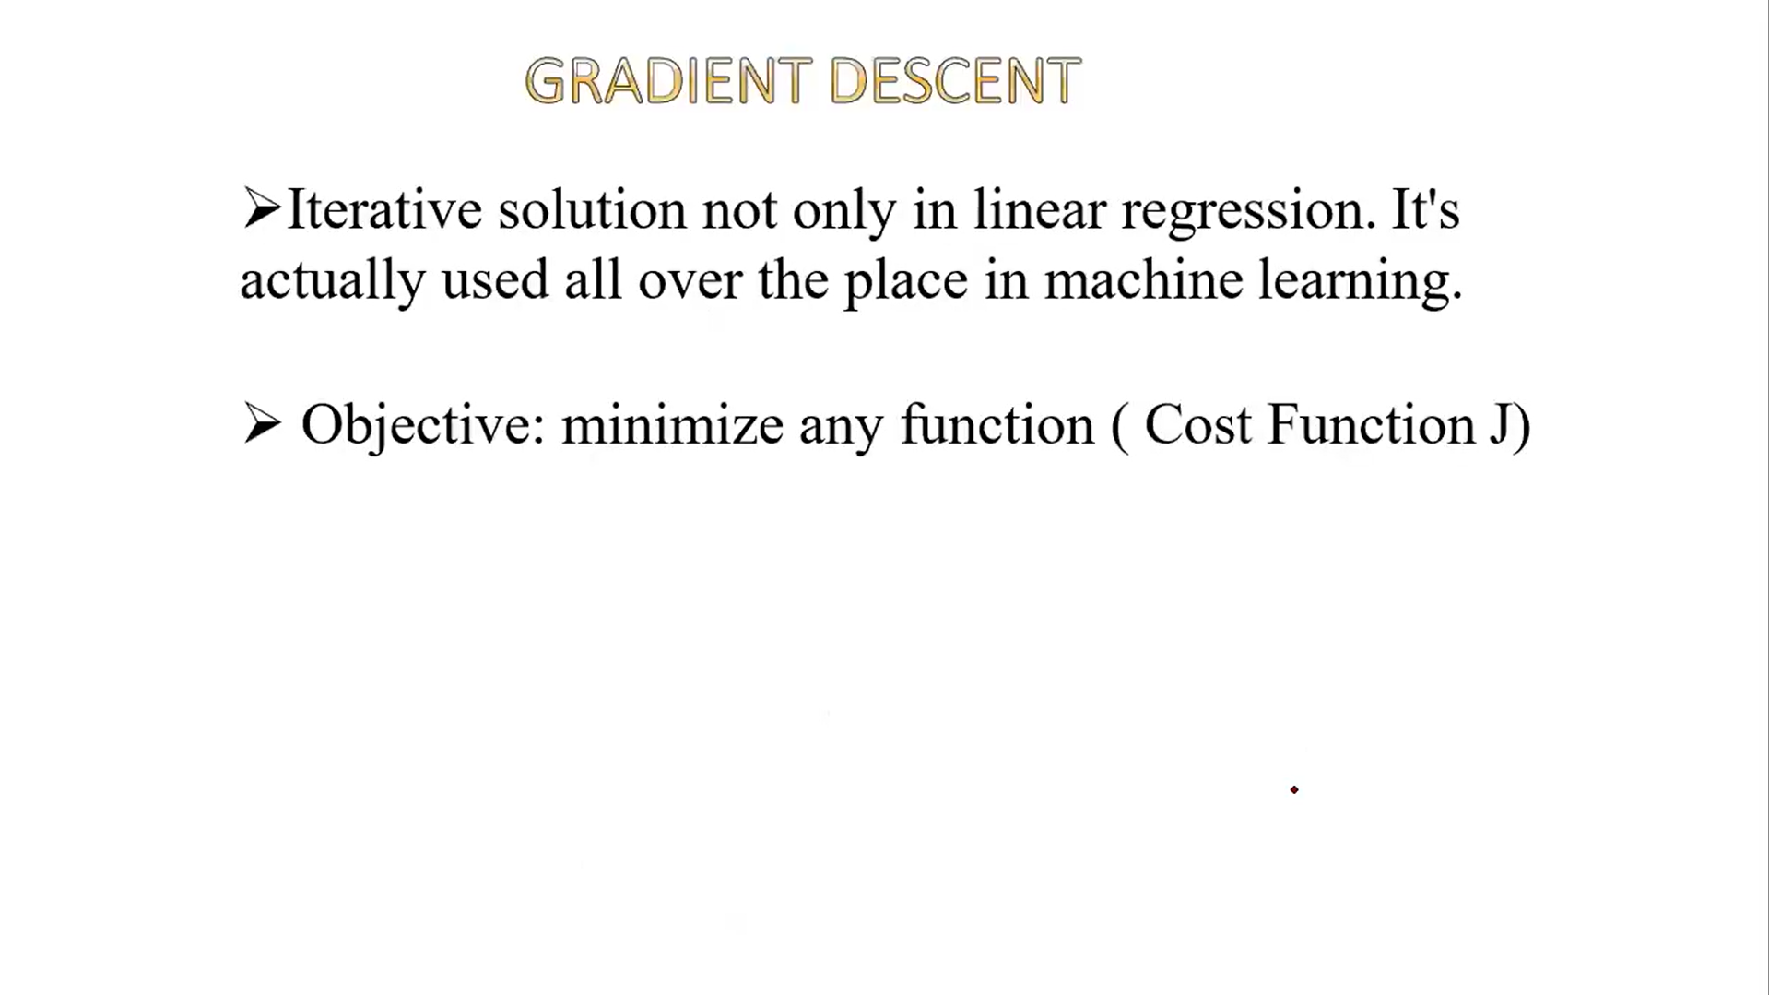

Slide 32
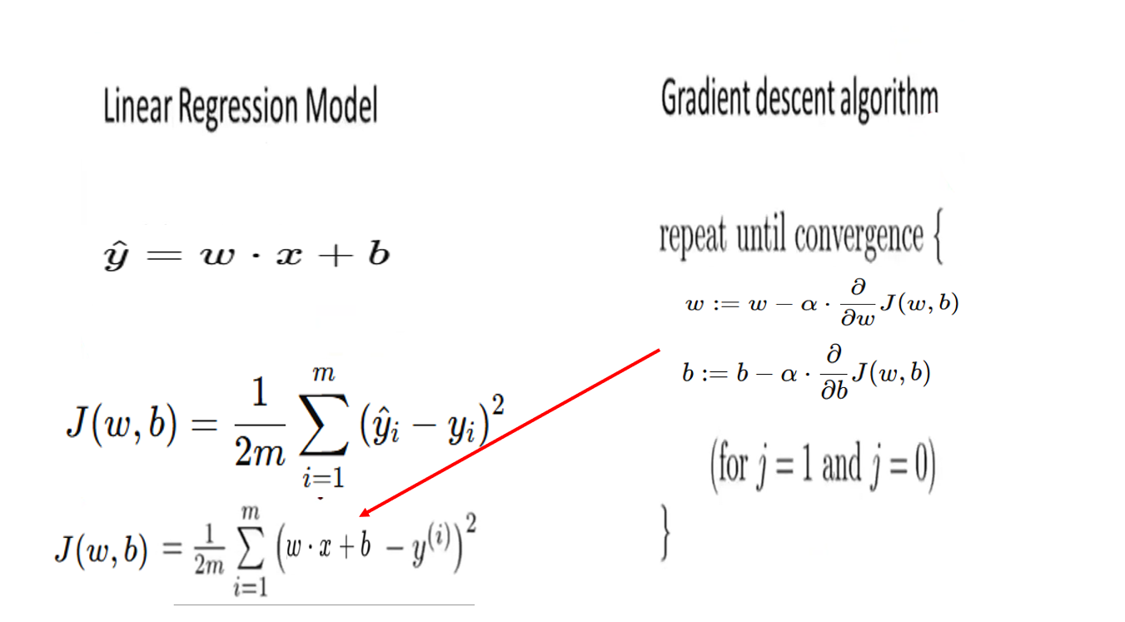

Slide 33
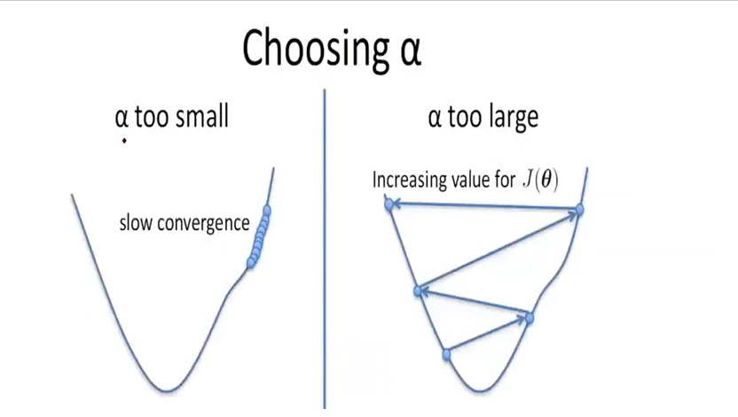

Slide 34
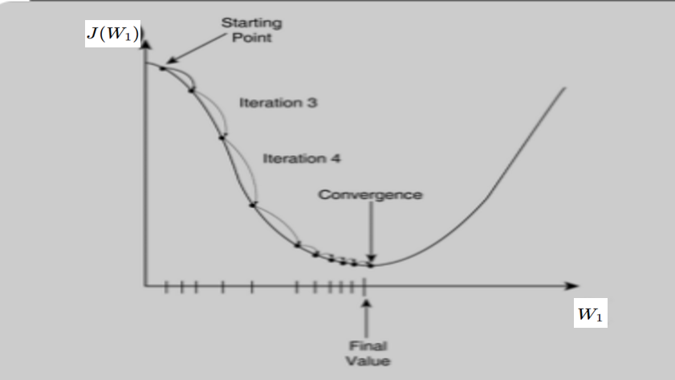

Slide 35


Testing 20%

